Slide 1
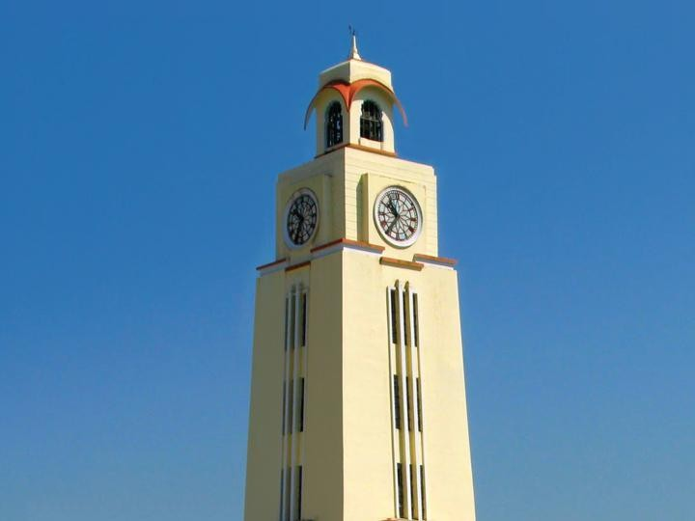

Artificial & Computational Intelligence
AIMLCZG557
Sample Problems
Indumathi V
Guest Faculty,
BITS - WILP
BITS Pilani
Pilani Campus

Slide 2
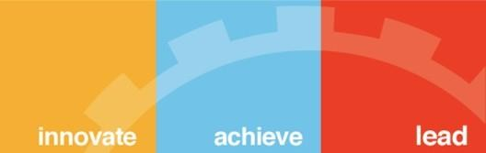
Sample Problems
BITS Pilani, Deemed to be University under Section 3 of UGC Act, 1956

Slide 3
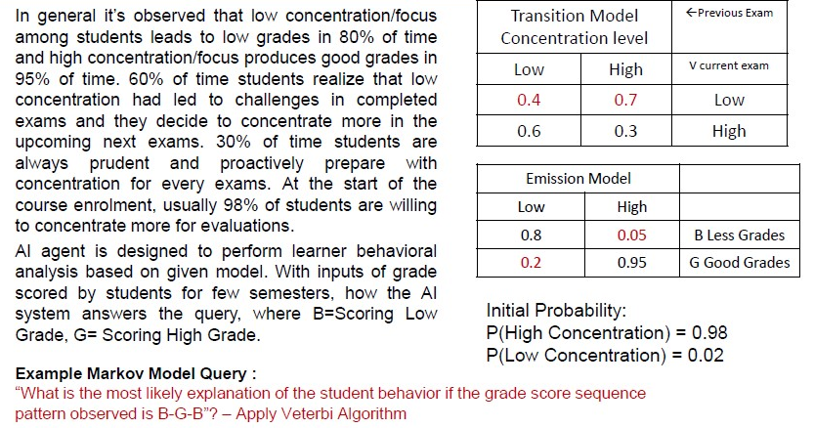
Explain HMM & Viterbi Algorithm

Slide 4
Explain HMM & Viterbi Algorithm

Slide 5
Explain HMM & Viterbi Algorithm

Slide 6
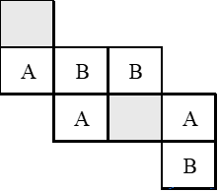
Gaming
Consider a 2-player game as in below diagram. The sliding-tile game consists of three “A” tiles, three “B” tiles, and two empty spaces. [Tile shaded in gray – Empty Space/Tile]. In this game a player wins if a pattern of player owned similar three tile are placed adjacent to each other. The term adjacency represents coins are in same row or same column. Assume the player with tile ‘A’ starts the move from this state. In the game, player “A” and “B” alternate in their turn.
The puzzle has two legal moves: which results in the swap of position of the tile with the empty location
Move #1: A tile may move into an adjacent empty location.
Move #2: A tile can only hop over one tiles in the same row into the empty position.
Expand the complete game tree (with neat diagram) from the given current state up to exactly 3 levels.
Calculate the utility of the leaves of the tree with below static evaluation function.
Utility value = [3*(MAX’s win chance – MIN’s win chance)] + [2*(MAX’s No.of.adjacent.pairs – MIN’s No.of.adjacents.pairs)]
Note: eg., For the given Initial configuration, MAX’s win chance is calculated as “In the current initial state 3 MAX coins ie., (A) are adjacent to empty cell and hence its win’s chance = 3.” and the MIN’s win chance is calculated as “In the current initial state 1 MIN coins ie., (B) is adjacent to empty cell and hence its win’s chance = 1.”
Apply the MIN MAX algorithm on the game tree

Slide 7
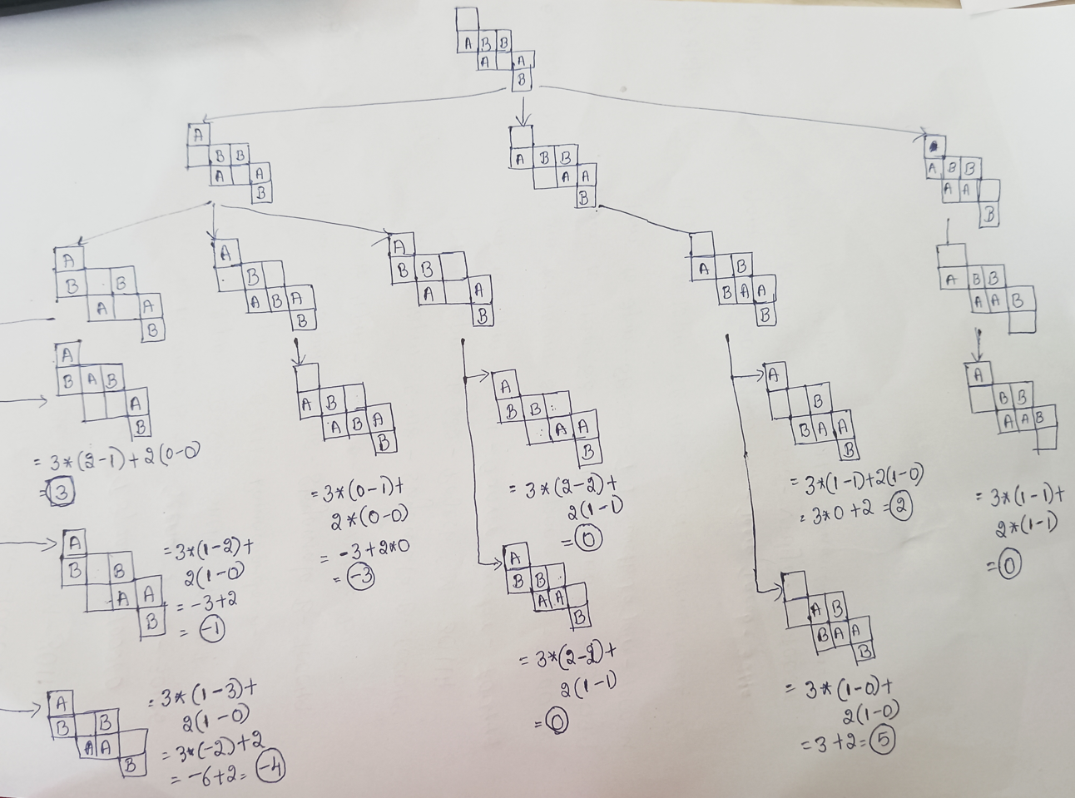
Gaming

Slide 8
Gaming

Slide 9
Logics
“In the marketing industry, all advertised products gain popularity. Not all profitable products have been popular, but all the popular products have been always profitable. Profitable products attract investments from corporates. “
Represent the knowledge base using propositional logic (without quantifiers) convert KB into CNF and find any three sample complete BSAT (Binary Satisfiability) solutions to the variables using DPLL algorithm. Suppose a customer is known to frequently purchase electronics but has ruled out being tech-savvy (¬T) with 100% certainty. Under this scenario, if the logic agent is asked, "Is the customer likely to receive recommendations for new electronic products?" how does the agent reason to answer the query? Prove by contradiction using the results obtained in part (a) by the resolution method.

Slide 10
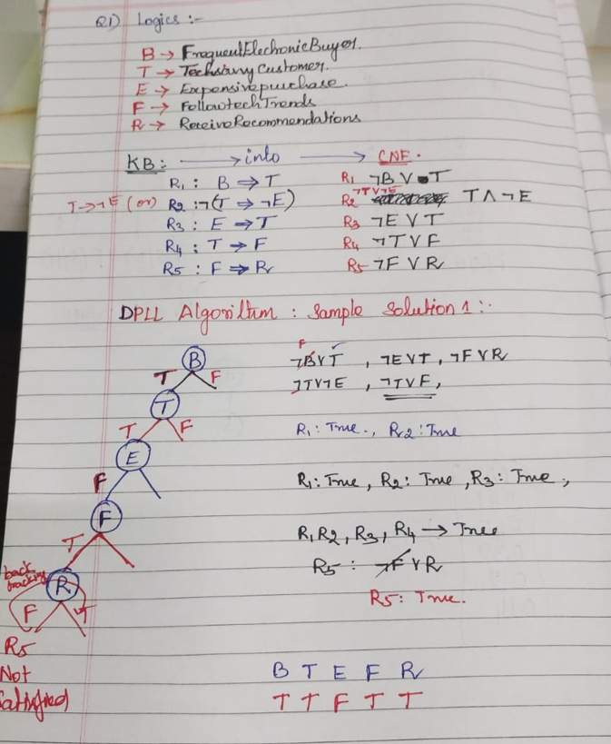
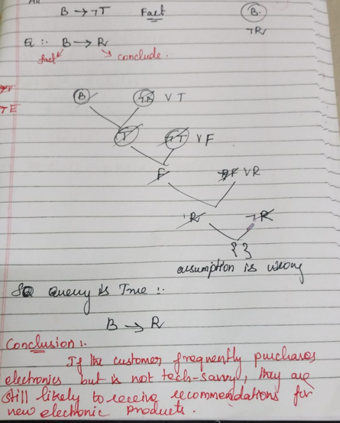
Logics

Slide 11
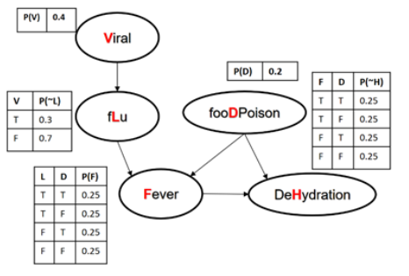
Bayesian Network
Consider the below Bayesian Network and answer the following questions:
Exact Inference : What is the chance that a person doesn’t get fever given the evidence that his/her blood test results show viral infection and severe dehydration?
Approximate inference – Prior Sampling, Rejection sampling, likelihood weighing,
“0.3, 0.6, 0.2, 0.1, 0.7, 0.5, 0.5, 0.25, 0.45, 0.85, 0.35, 0.9, 0.15, 0.65, 0.51, 0.2, 0.7, 0.10, 0.6, 0.8”

Slide 12
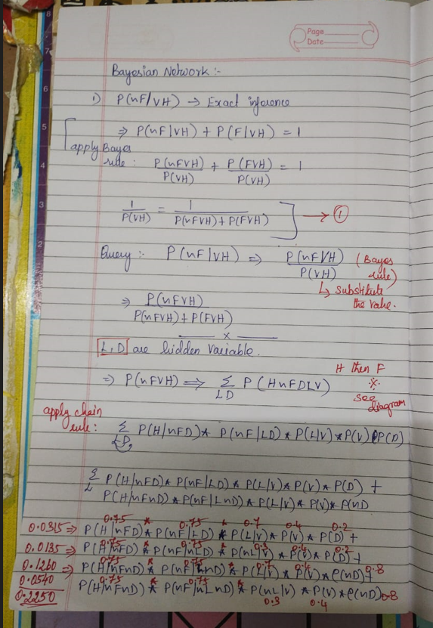
Bayesian Network
Exact Inference : What is the chance that a person doesn’t get fever given the evidence that his/her blood test results show viral infection and severe dehydration?
Approximate inference – Prior Sampling, Rejection sampling, likelihood weighing,
“0.3, 0.6, 0.2, 0.1, 0.7, 0.5, 0.5, 0.25, 0.45, 0.85, 0.35, 0.9, 0.15, 0.65, 0.51, 0.2, 0.7, 0.10, 0.6, 0.8”

Slide 13
Bayesian Network
Exact Inference : What is the chance that a person doesn’t get fever given the evidence that his/her blood test results show viral infection and severe dehydration?
Approximate inference – Prior Sampling, Rejection sampling, likelihood weighing,
“0.3, 0.6, 0.2, 0.1, 0.7, 0.5, 0.5, 0.25, 0.45, 0.85, 0.35, 0.9, 0.15, 0.65, 0.51, 0.2, 0.7, 0.10, 0.6, 0.8”

Slide 14
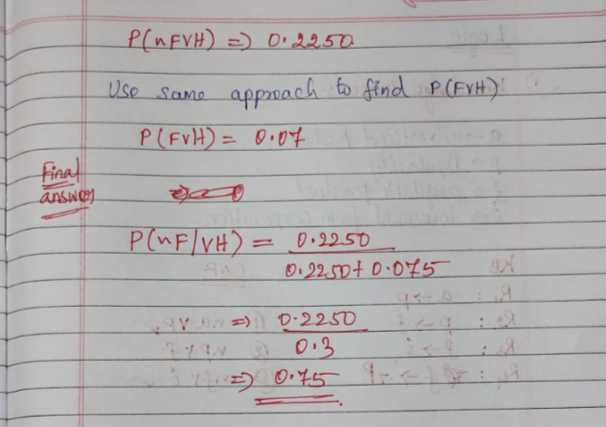
Bayesian Network
Exact Inference : What is the chance that a person doesn’t get fever given the evidence that his/her blood test results show viral infection and severe dehydration?
Approximate inference – Prior Sampling, Rejection sampling, likelihood weighing,
“0.3, 0.6, 0.2, 0.1, 0.7, 0.5, 0.5, 0.25, 0.45, 0.85, 0.35, 0.9, 0.15, 0.65, 0.51, 0.2, 0.7, 0.10, 0.6, 0.8”

Slide 15
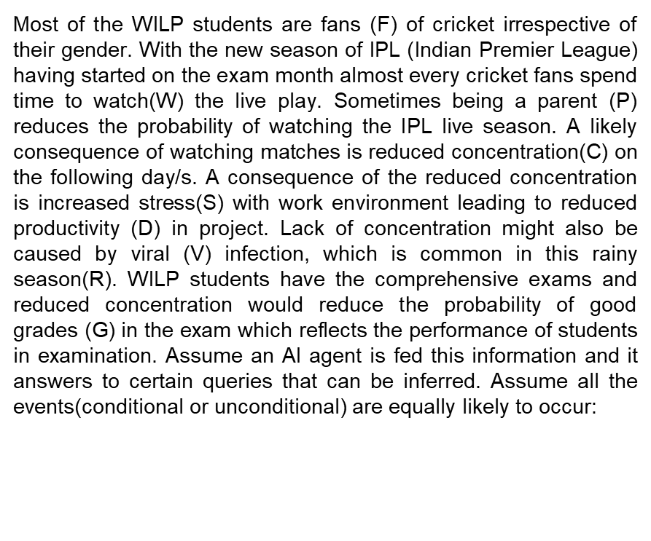
Bayesian Network

Slide 16
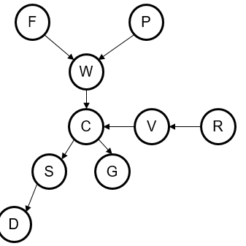
Bayesian Network

Slide 17
Bayesian Network
Example Joint Prob.Distribution Query :
What is the chance that “an ardent fan of cricket who is a parent of two kids, never misses an IPL match, doesn’t get stressed in work environment, is affected by viral infection and performs well in the comprehensive examination”?
D-Seperation:Performance of in the examination is independent of stress in work environment given its known that the student is affected by viral infection

Slide 18
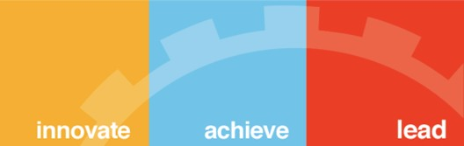
Required Reading: AIMA - Chapter #15.1, #15.2, #15.3, #20.3.3
Thank You for all your Attention
Note : Some of the slides are adopted from AIMA TB materials
BITS Pilani, Deemed to be University under Section 3 of UGC Act, 1956

